Slide 1
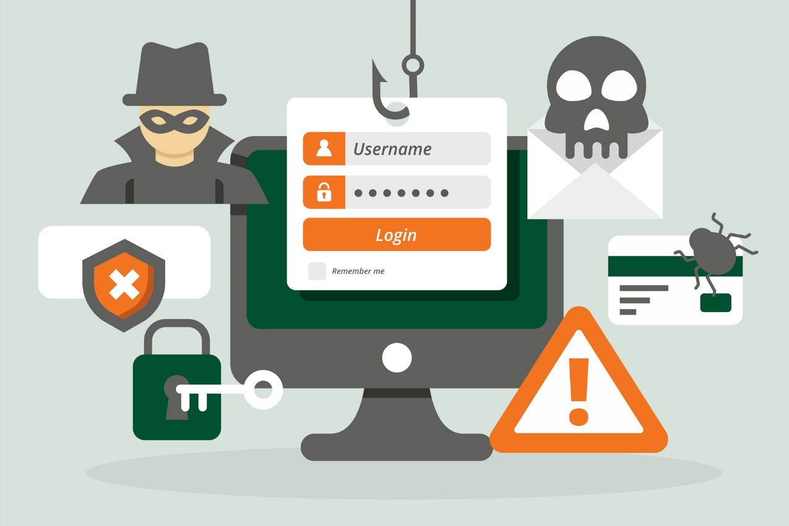
Phishing Awareness Training Recognizing and Avoiding Cyber Threats
MD SADAT TAMZIT
Internship Task From CODE ALPHA
Student ID : CA/CS1/13317

Slide 2
Introduction
Welcome to Phishing Awareness Training
Thank you for joining us for this important training session on recognizing and avoiding phishing attacks.
Importance of Phishing Awareness
Phishing attacks are one of the most common and dangerous cyber threats faced by individuals and organizations today.
Prevalence of Phishing Attacks
Phishing attacks have become increasingly sophisticated and prevalent, targeting individuals and organizations of all sizes and industries.

Slide 3
What is Phishing?
Phishing is a type of cyber attack where attackers use deception and manipulation techniques to trick individuals into revealing sensitive information, such as passwords, credit card numbers, or social security numbers. Phishing attacks often involve impersonating a trusted entity, such as a bank, government agency, or well-known company, in order to gain the victim's trust and obtain their confidential information.
Examples of Phishing Attacks
Emails: Attackers send fraudulent emails that appear to be from a legitimate source, such as a bank or an online service provider. These emails often contain urgent requests for personal information or ask the recipient to click on a malicious link.
Websites: Phishing websites are designed to mimic legitimate websites, such as online banking portals or e-commerce platforms. These websites trick users into entering their login credentials or financial information.
Social Engineering: Attackers may also use social engineering techniques to manipulate individuals into revealing sensitive information. This can involve impersonating a colleague, friend, or family member and requesting personal information or login credentials.

Slide 4
Types of Phishing Attacks
Email Phishing
Most common type of phishing attack
Attackers send fraudulent emails that appear to be from a legitimate source
Emails often contain malicious links or attachments
Spear Phishing
Targeted phishing attack
Attackers personalize emails to specific individuals or organizations
Emails often appear to be from a trusted source
Vishing
Phishing attack conducted over phone calls
Attackers impersonate legitimate organizations or individuals
Aim to trick victims into revealing sensitive information
Smishing
Phishing attack conducted via SMS or text messages
Attackers send fraudulent messages with malicious links or requests for personal information
Messages often appear urgent or alarming

Slide 5
The Anatomy of a Phishing Email
Generic Salutations
Phishing emails often use generic salutations like 'Dear Customer' or 'Dear User' instead of addressing you by your name.
Urgent or Threatening Language
Phishing emails may contain urgent or threatening language to create a sense of urgency and manipulate you into taking immediate action.
Unusual Sender Addresses
Be cautious of emails from unfamiliar or suspicious sender addresses. Phishing emails may use addresses that mimic legitimate organizations or contain misspellings.
Unexpected Attachments or Links
Phishing emails may include unexpected attachments or links. Be wary of clicking on links or downloading attachments from unknown sources.
Requests for Sensitive Information
Phishing emails often request sensitive information like passwords, credit card numbers, or social security numbers. Legitimate organizations will never ask for this information via email.

Slide 6
Identifying Phishing Websites
Tips for Identifying Phishing Websites
Look for HTTPS in the URL: Legitimate websites use HTTPS to encrypt data and provide a secure connection. Check for the padlock icon in the address bar.
Verify the website's legitimacy: Pay attention to the domain name and look for any misspellings or variations that may indicate a phishing attempt.
Be cautious of pop-ups and redirects: Phishing websites often use pop-ups and redirects to trick users into revealing sensitive information.
Trust your instincts: If something seems suspicious or too good to be true, it's better to be cautious and avoid interacting with the website.

Slide 7
Recognizing Social Engineering Tactics
Building Trust
Phishing attackers may impersonate trusted entities such as banks, social media platforms, or well-known brands.
They use logos, email signatures, and other elements to make their messages appear legitimate.
Exploiting Authority
Attackers may pose as someone in a position of authority, such as a manager, IT support, or a company executive.
They use this authority to request sensitive information or to convince targets to take certain actions.
Creating a Sense of Urgency
Phishing emails often create a sense of urgency, pressuring recipients to act quickly without thinking.
Attackers may claim that an account has been compromised, a payment is overdue, or an important deadline is approaching.
Appealing to Emotions
Phishing attackers may use emotional manipulation to trick targets into taking action.
They may appeal to fear, curiosity, greed, or sympathy to increase the chances of success.

Slide 8
Reporting Phishing Attacks
Internal Reporting Procedures
Employees should report any suspected phishing attacks to their immediate supervisor or designated point of contact.
Internal reporting procedures may include submitting a report via email, using an internal incident reporting system, or contacting the IT or security teams.
Reporting to IT or Security Teams
In addition to internal reporting, employees should also notify the IT or security teams within the organization.
IT or security teams can investigate the incident, take appropriate actions to mitigate the threat, and provide guidance to affected individuals.
Reporting to External Organizations
Reporting phishing attacks to external organizations, such as Anti-Phishing Organizations, can help in taking down fraudulent websites and preventing further attacks.
External organizations may have dedicated reporting mechanisms or email addresses for reporting phishing attacks.

Slide 9
Important for Phishing Guidance Actively
Personal Information Security:
Phishing scams are designed to steal sensitive data such as credit card details, social security numbers, and login credentials. Active vigilance can prevent unauthorized access to your personal information, protecting you from identity theft.
Financial Protection:
Phishing attacks often lead to financial fraud. By understanding and applying phishing guidance, you can avoid fraudulent transactions, saving you from financial losses.
Maintaining Privacy:
Falling for a phishing attack can lead to privacy breaches, exposing your personal communications, photos, and other private data.
Protecting Professional Information:
If you use your devices for work, they likely contain or have access to confidential business information. Following phishing guidance helps ensure the security of this data, thereby maintaining the trust of your employer and clients.
Preventing Malware:
Phishing scams can also include harmful software. Clicking on a phishing link can install malware on your device, which can corrupt files, slow down your device, or turn it into a part of a botnet.
Building Safe Online Habits:
By following phishing guidance, you develop safe habits that can protect you from other cyber threats as well. This includes being cautious about sharing personal information and double-checking the security of websites.
Educating Others:
When you’re knowledgeable about phishing threats, you can educate your colleagues, friends, and family, helping to create a safer digital community.

Slide 10
Preventing and Responding to Phishing Attacks
Be Suspicious of Unsolicited Communications:
Treat any unsolicited communication with caution, especially if it asks for personal or financial information. Legitimate organizations typically don’t request sensitive information via email.
Check the Email Address:
Phishing emails often come from email addresses that resemble genuine company addresses but are slightly altered or misspelled.
Check for Spelling and Grammar:
Many phishing emails have spelling or grammatical errors. While legitimate companies can occasionally make mistakes, multiple errors are a warning sign.
Avoid Clicking Links in Emails:
If an email asks you to log in to an account, manually type the website’s address into your browser instead of clicking the link.
Verify a Site’s Security:
Ensure the site is secure before entering any information. Look for “https://” in the URL – the “s” stands for secure.
Install Anti-Phishing Toolbars:
Some browsers offer free anti-phishing toolbars. These toolbars match where you are going with lists of known phishing sites and will alert you.

Slide 11
Preventing and Responding to Phishing Attacks
Keep Your Browser Up to Date:
Security patches are released for popular browsers all the time. They are made in response to the security loopholes that phishers and other hackers inevitably discover and exploit.
Use Firewalls:
Use a desktop firewall and a network firewall. This combination provides a double layer of defense against phishing attacks.
Be Wary of Pop-Ups:
Pop-up windows often masquerade as a legitimate part of a website. Be wary of entering any information into them.
Regularly Check Your Accounts:
Regularly check your bank, credit, and debit card statements to ensure that all transactions are legitimate.
Use Two-Factor Authentication (2FA):
Always enable 2FA when it’s available. It adds an extra layer of security by requiring additional verification.
Education and Awareness:
The best protection against phishing is awareness. Understand what phishing is and stay updated on the latest phishing tactics.

Slide 12
Anti-Phishing Tools and Technologies
Anti-Phishing Tools and Technologies
Tool/Technology | Description
Email Filters and Spam Detection | Email filters and spam detection software help identify and block phishing emails by analyzing email content, sender reputation, and other indicators of suspicious activity.
Security Awareness Training Programs | Email filters and spam detection software help identify and block phishing emails by analyzing email content, sender reputation, and other indicators of suspicious activity.
Browser Extensions for Phishing Protection | Browser extensions provide an additional layer of protection by detecting and blocking known phishing websites, displaying warnings when visiting suspicious sites, and offering real-time phishing threat intelligence.

Slide 13
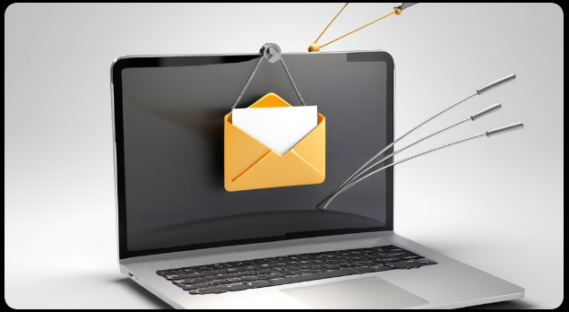
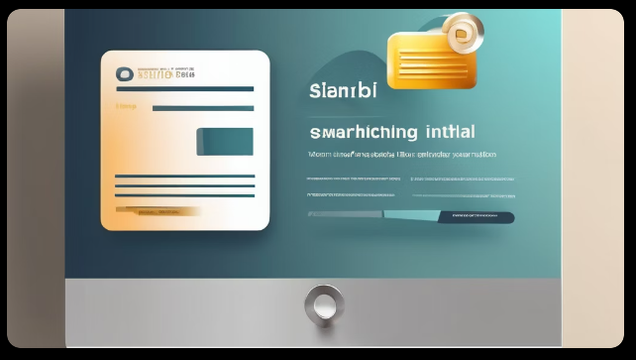
Case Studies and Examples
Case Study 1
A major company fell victim to a phishing attack, resulting in the compromise of sensitive customer data. This incident led to reputational damage and financial losses for the company.
Case Study 2
An employee unknowingly clicked on a phishing link, leading to a malware infection on their computer. This allowed hackers to gain unauthorized access to the company's network and steal valuable intellectual property.

Slide 14

Conclusion
Recap of Key Points
Phishing attacks are a common cyber threat that targets individuals and organizations.
Phishing emails and websites often mimic legitimate sources to deceive users.
Be cautious of suspicious emails, links, and attachments.
Regularly update and strengthen your passwords to protect your accounts.
Enable multi-factor authentication for an extra layer of security.
Report any suspicious activity to your IT department or security team.
Importance of Ongoing Vigilance
Phishing attacks are constantly evolving, so it's crucial to stay informed and updated on the latest threats.
Ongoing training and awareness programs can help individuals and organizations stay vigilant against phishing attacks.
Regularly review and reinforce security protocols to ensure continued protection.

Slide 15
References
ChatGpt
https://www.empowerelearning.com/blog/understanding-phishing-recognize-prevent-phishing-attacks/
https://ung.edu/information-technology/information-security/phishing-awareness.php
https://cehs.usu.edu/scce/files/phishing-awareness.pdf
Thank You
Thank you for participating in this phishing awareness training. Your commitment to cybersecurity is essential in safeguarding our organization's sensitive information.

